Slide 1
Computer Science II Final Project
Sarah Sollauer

Slide 2
Motivation
My program is a simple game that is intended to teach young people about what items can and cannot be recycled.
If the item can be recycled you gain a point when selecting that option, if you click “trash” on a recyclable item, you lose a point and vice versa. If you get 9 points or more, you win the game.

Slide 3
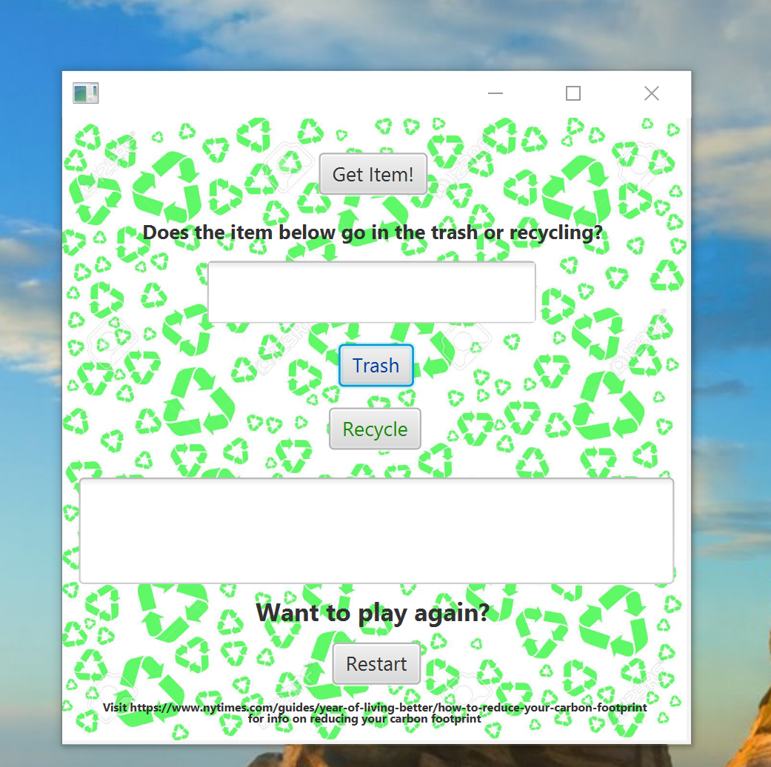
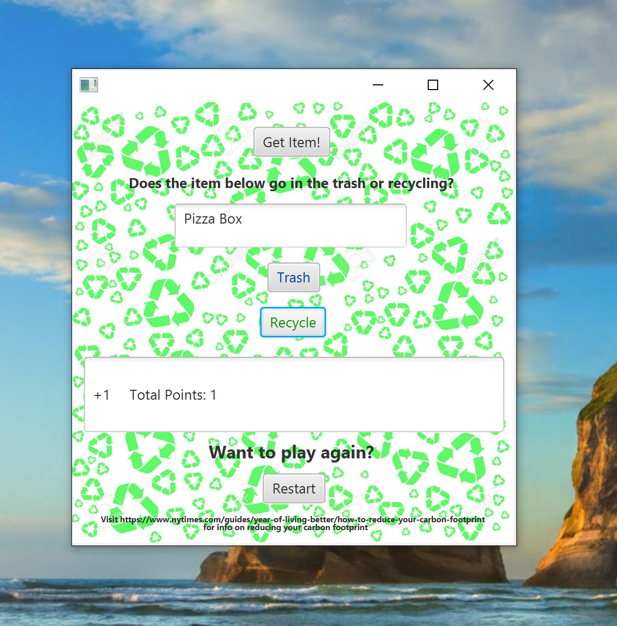
Screenshots

Slide 4
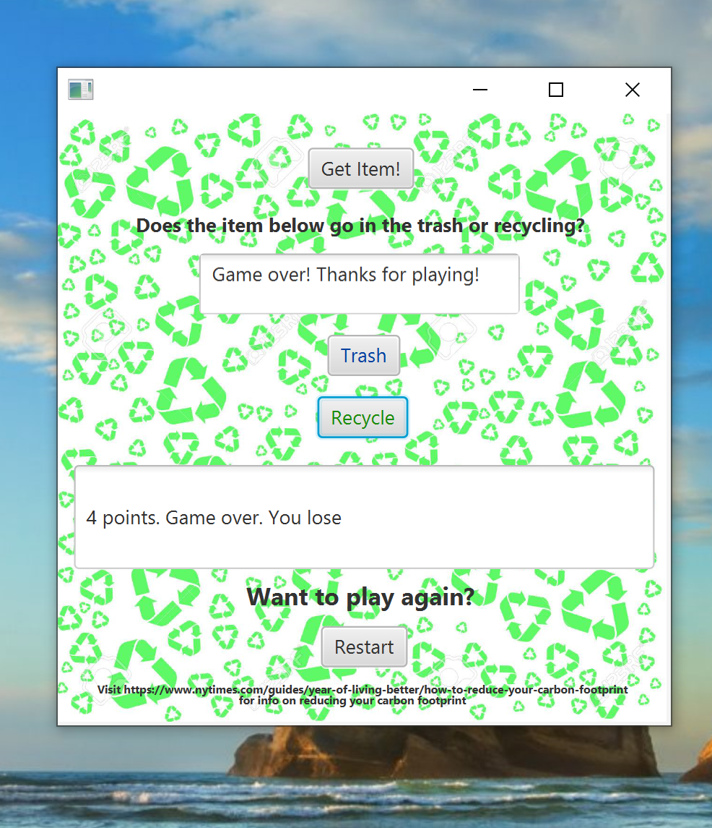
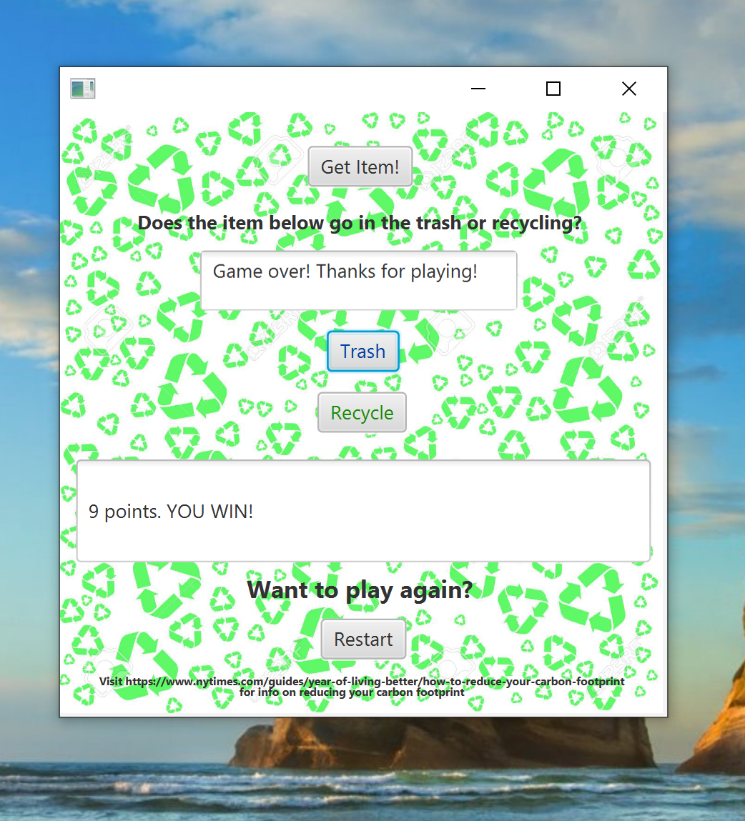

Slide 5
Algorithms, tools, libraries
In my program, I used class definition with the wordInformation.java class which did not include main/ static methods or variables.
The GarbageApplication.java class called methods from WI(wordInformation) and used them. The main purpose of the wordInformation class was to define an arrayList, which is an example of an iterator. The list includes items that are either thrown away or recycled.
It also dealt with assigning each word to the correct button click.
The garbageApplication class inherited javaFX’s application class and implemented initializable, which is a Java interface that allows you to call the initialize() method. This method is where I interjected all FXML information.

Slide 6
Thanks!

